Slide 1
Current Cluster Team Structure since 11th July 2017
Laurent de Valensart - UNHCR National Cluster Coordinator +964 (0) 771 994 5694 coord.iraq@sheltercluster.org Michel Tia - IOM Information Management Officer - National +964 (0) 750 021 1720 im2.iraq@sheltercluster.org Cornelius Weira - IOM Sub National Co-Chair - Centre and South +964 (0) 751 234 2548 coord4.iraq@sheltercluster.org Laurence West - UNHCR Sub National Coordinator – KRI +964 (0) 771 911 0574 coord3.iraq@sheltercluster.org | Andrea Quaden - NRC National Cluster Co-Chair +964 (0) 751 740 7635 coord2.iraq@sheltercluster.org Abdoulaye Dieye - NORCAP Information Management Officer - Assistant National +964 (0) 771 488 2672 im3.iraq@sheltercluster.org Tonja Klansek - ACTED Roving Cluster Coordinator +964 (0) 773 725 8092 coordroving.iraq@sheltercluster.org Vacant (under recruitment) - UNHCR Senior Cluster Associate +964 (0) 000 000 0000 snrnatassot.iraq@sheltercluster.org

Slide 2
Sub-National Shelter & NFI Cluster Coordination meeting for C&S
1. Review of minutes of previous meeting 2. Information Management Updates 3. Hawiija Response Updates – (Needs and Gaps) 4. Western Anbar Response Updates – (Needs and Gaps) 5. Tent Replacement (Kilo 18, AAF camps etc.) 6. Winterisation / Climatisation Guidance Vrs6 7. Governorate Updates 8. AoB
Wednesday, 27th September 2017
http://sheltercluster.org/response/iraq

Slide 3
1. Review of action points from previous meeting
Partners Monthly Achievements: Partners to ensure regular reporting into activity info;
2018 HNO exercises: Partners to share their completed assessments reports / Raw data and Planned assessments as input for HNO document – Ongoing
Partners urged to share updates on current stocks and pipeline for Hawiija and Western Anbar response preparedness – Ongoing
Partners reminded to share Winterization plans with the Cluster Coordinator – Ongoing
Cluster Sub National Coordinator to refer case of lack of water for IDPs at Rutba (Nadhira screening point) to the Rapid Response Mechanism (RRM) sub cluster for urgent action –Done
Cluster Sub National Coordinator to share tent replacement data with cluster IMO for development of Dashboard on tent replacement – Ongoing
Shelter Focal Points to share MOMD reports on tent replacement activities – Pending

Slide 4
Information Management Update – Achievements Jan. – Aug. 2017 - KEY FIGURES
Closed or never started |  | At risk of closure or reduction |  | Project received 90-100% funding
FUNDING PROGRESS – 26 Sept.17
Cluster | # Projects | Percentage of Red Projects | Percentage of Yellow Projects | Percentage of Green Projects
Shelter NFI | 50 | 22 | 15 | 13
COVERAGE AGAINST TARGETS (HH)
Operational Partners (reporting): 36
People in need: 3.9 M
Targeted: 2.3 M

Slide 5
Information Management Update – Achievements Jan. – Aug. 2017
Out of the overall target of 2.3 million, 1,601,640 people have been assisted with non-food items kits; 678,402 of which have also benefited from shelter interventions. The coverage for non-food items kits stands at 69% of the cluster target; and the coverage for shelter stands at 29% of cluster target.
From the total reached beneficiaries.
1,584,348 of vulnerable people were provided with safe and appropriate critical life-saving non-food items, 465,366 of which benefited from appropriate emergency shelter interventions in first line response.
In second line response, 203,982 people were assisted with shelter upgrade and basic repair interventions including 17,292 people with critical life-saving non-food items replenishment.
9,054 people were assisted in full cluster response which consist of expand safe, dignified shelter and housing options in accordance with the cluster agreed standards.
However major gaps to be considered remain at governorate level

Slide 6
Information Management Update – Achievements Jan. – Aug. 2017
Operational Partners (reporting): 36

Slide 7
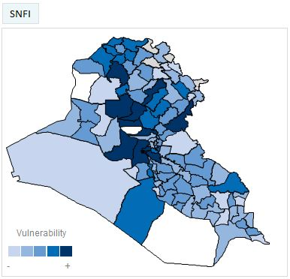
Information Management Update – 2018 HNO Process – S-NFI Severity Map
2018_Shelter and NFI Severity Map
The Severity Map and related data & indicators were presented to the Cluster SAG on 14 Sept.17 for review and approval.
On 24Sept.17 SAG approved Severity Map was shared with OCHA.
Clusters are waiting for the Humanitarian Profile to populate their 2018_Cluster PIN.

Slide 8
Hawiija Response Updates – (Needs and Gaps)
Site name | capacity | Tents needed | Covered by | Available | Gap | Tent witnerization needed | Available | Gap | Covered by | NFI needed | Covered by | Available | Gap
Laylan 3 | 1,541 | N/A | UNHCR | 1,541 | 0 | 1541 | 0 | 1541 | UNHCR | 800 | IOM | 800 | 0
Karamah | 1345 | N/A | MODM | 720 | 0 | 720 | 0 | 720 | MODM | 720 | RRIP(UNHCR Implementing partner) | 0 | 720
Al-Hardania | 85 | N/A | IOM/MODM type | 85 | 0 | 85 | 0 | 85 | IOM | 85 | IOM/MODM in the past what NOW? | 85
Tikrit Olympic Stadium | 1000 | N/A | RRIP( UNHCR IP) | 1000 | 0 | 1000 | 0 | 1000 | UNHCR | 1000 | RRIP (UNHCR Implementing partner) | 1,000 | 0
Basateen Al Sheuokh | 1000 | 27 | MODM | 1000 | 0 | 1000 | 0 | 1000 | MODM | 1000 | IOM | 1000 | 0
Basateen Al Sheuokh | 1000 | 1000 | IOM | 0 | 1000 | 1000 | 0 | 1000 |  | 1000 | ACTED | 1000 | 0
Al-Alam 3/4 | 3200 | N/A | MODM | 3200 | 0 | 3200 | 0 | 3200 | MODM | 3200 | RRIP (UNHCR Implementing partner) | 3,200 | 0
Samra | 3200 | N/A | MODM | 3200 | 0 | 3200 | 0 | 3200 | MODM | 3200 |  | 3200 | 0
Salamyia 3 | 1000 | 1000 | UNHCR | 1000 | 0 | 1000 | 0 | 1000 | UNHCR | 1000 | ACTED (UNHCR implementing partner) | 1000 | 0
Al-Alam 5 | 500 | 500 | MODM | 0 | 500 | 500 | 0 | 500 | MODM | 500 |  | 0 | 500
 |  |  |  | 11,746 | 1,500 | 13,246 |  | 13,246 |  | 12,505 |  | 11,285 | 1,220

Slide 9
Western Anbar Response Updates – (Needs and Gaps)

Slide 10
Western Anbar Response Updates – (Needs and Gaps)

Slide 11
Tent Replacement (Kilo 18, AAF camps etc.)
Tent Replacement (Kilo 18, AAF camps etc.)
Received figures from UNHCR - 324 tents replaced in HTC camps during the period.
Tents so far replaced 8,313 ; Current Gap 14,687 needed for Camps in AAF, HTC and AK

Slide 12
Winterisation / Climatisation Guidance Vrs6
Climatisation Guidance Vrs 6 has been shared with Partners for input and is currently before the SAG for endorsement.

Slide 13
Governorate Updates
UNHCR
Anbar:
587 CRI kits distributed for new arrival IDPs in AAF, K18 and HTC camps 35,8,9,10.
606 tents installed for new arrivals inside camps in HTC, AAF and new extension at K18.
UNHCR Completed construction of extension of Kilo 18 Camp with capacity of 576 tents.
Salah a Din:
269 CRI kits were distributed for new arrivals in Shahma wa Karama camp and in Al-Alam 1,2 camps

Slide 14
AOB
IHPF allocations for Hawiija Response
Baseteen 2tent Installation and drainage( Baseteen 1&2) - $ 0.6 Mn
NFI Kits &Winterisation and winter top up kits ( Kirkuk and SAD)- $ 2.15 Mn
SOK ( Shirqat and Kirkuk) -$ 0.25mN
Total $ 3.0 Mn
Only 3 Proposals expected on the three different lines ; Consortiums encouraged
Deadline for submission 3rd October 2015
Next meeting will be Wednesday 11th October 2017
11: 30 pm at RCC4

Slide 15
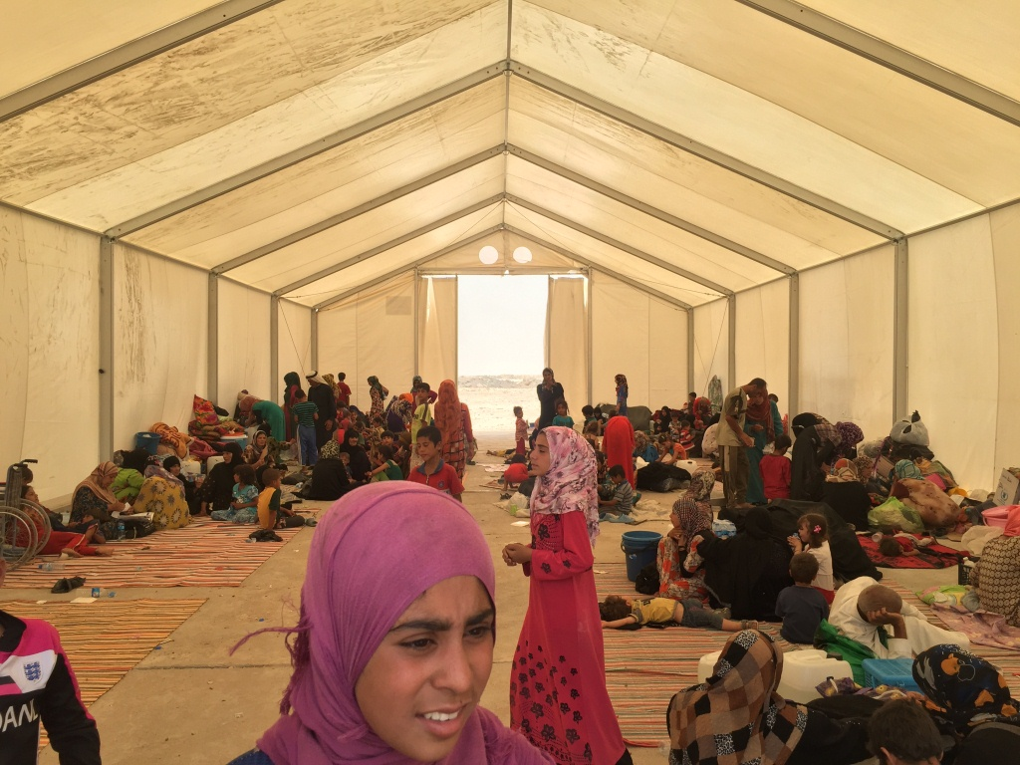
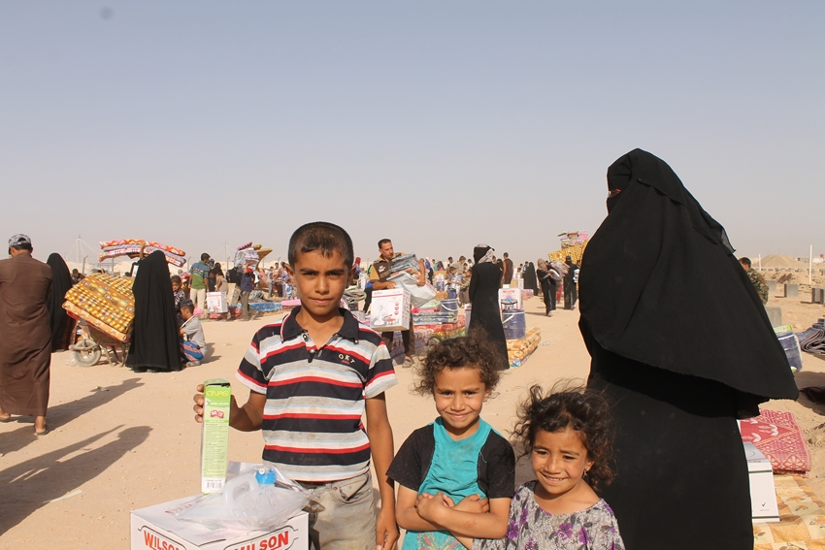
THANKS.
http://sheltercluster.org/response/iraq

